Slide 1
COEN 275 Object-Oriented Analysis, Design and Programming (4 units)
Paddu Melanahalli
pmelanahalli@scu.edu
School of Engineering/Graduate Engineering
Slide & teaching content is from internet and books – copyright belongs to respective owners.

Slide 2
Program Organization
Program statement
Definition, e.g. function prototype
Declaration, e.g. variables and constants
Action
Executable unit - Action
Set of program statements – may be named
Different languages refer to named executable units by different names
Subroutine: Fortran and Basic
Procedure: Pascal
Function: C++
Method: C++, C#, Java

Slide 3
The simplest C++ program consists of a single function named main.
The syntax of such programs is shown below:
#include <iostream>
using namespace std;
int main()
{
declaration(s);
statement(s);
return 0;
}
The portions of the program shown in blue should always be present.
The declarations specify the data that is used by the program. These declarations can declare either constants or variables, for example.
The statements specify the algorithm for the solution to your problem.

Slide 4
Statements
Statements are the executable “units” of a program.
Statements are the translation of an algorithm into program code.
Statements may be
- Simple – typically one line of program code
- Structured – a grouping of a number of statements
E.g. control structures; functions; etc.
Statements must be terminated with a ; symbol.

Slide 5
Program statements may be executed by one of three control structures:
- Sequence – execute statements one after the other
- Selection – select which statement(s) to execute
- Repetition – repeatedly execute statement(s)
#include <iostream>
using namespace std;
int main()
{
declaration(s);
statement(s);
return 0;
}

Slide 6
The #include Directive
Preprocessor directive
Inserts the contents of another file into the program
iostream is C++ library of input/output functions
This includes
cout (printing) and
cin (accept keyboard input from the user)
Do not use ; at end of #include statement
#include <iostream>
using namespace std;
int main()
{
declaration(s);
statement(s);
return 0;
}

Slide 7
The namespace Directive
Namespaces prevent naming conflicts. In large projects or when importing libraries, namespaces are essential for disambiguating exactly the symbols you’re looking for.
This directive allows the cout and cin statements to be used in a program without using the prefix std::
With this directive, may write
cin or cout
Otherwise, we would have to write
std::cout or std::cin
Must use ; at end of namespace directive
#include <iostream>
using namespace std;
int main()
{
declaration(s);
statement(s);
return 0;
}

Slide 8
Declarations - Constants and Variables
Constants are data that having unchanging values.
Variables, as their name implies, are data whose values can change during the course of execution of your program.
For both constants and variables, the name, the data type, and value must be specified.
Any variable in your program must be defined before it can be used
Data type specifies whether data is integral, real, character or logical.

Slide 9
Constants
Syntax
const type name = expression;
The statement must include the reserved word const, which designates the declaration as a constant declaration.
The type specification is optional and will be assumed to be integer.
Examples
const float TAXRATE = 0.0675;
const int NUMSTATES = 50;
void petruchio(const char* shrew) {
cout << "Fear not, sweet wench, they shall not touch thee“ << shrew;
shrew[0] = "K"; // Compiler error! The shrew cannot be tamed.
}
Convention is to use uppercase letters for names of constants.

Slide 10
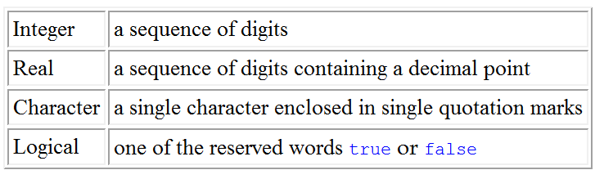
The data type of a constant

Slide 11
A Simple, Yet Complete, C++ Program
Program producing output only
// Hello world program
#include <iostream>
using namespace std;
int main()
{
cout << "Hello world!" << endl;
return 0;
}
Comment
Preprocessor
directives
Function named main() indicates start of the program
Ends execution
of main() which ends the program

Slide 12
Let us look at the function main()
int main()
{
cout << "Hello world!" << endl;
return 0;
}
This example introduces the notion of a text string
"Hello world!"

Slide 13
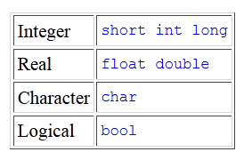
The basic data types
The three integer types allow for whole numbers of three different sizes.
The two real types permit numbers with decimal parts with two different amounts of precision.
Finally, there is one type for character data that consists of a single character, and one type for logical values that are either true or false.

Slide 14
The cout Output Statement
Used to display information on computer screen
It is declared in the header file iostream
Syntax
cout << expression;
Uses << operator to send information to computer screen
cout << "Hello, there!";
Can be used to send more than one item
cout << "Hello, " << "there!";

Slide 15
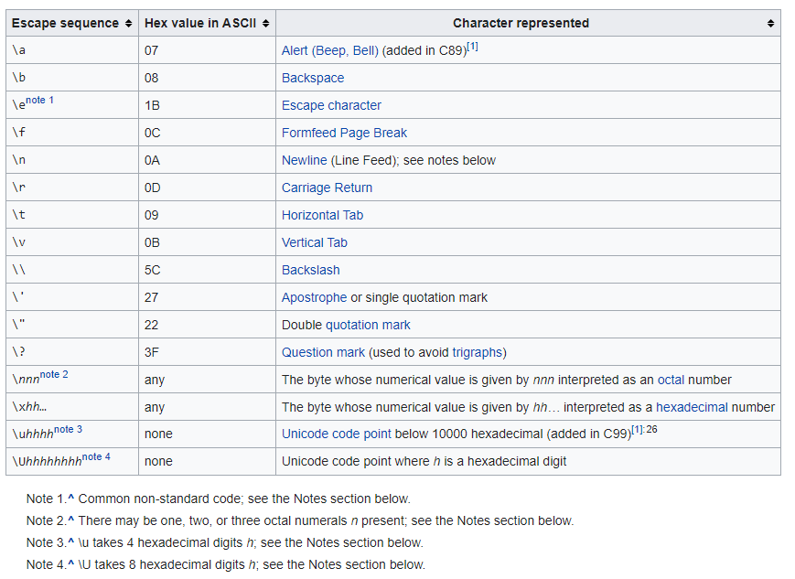
To get multiple lines of output on screen
Either
- Use the endl function
cout << "Hello, there!" << endl;
Or
- Use \n in the output string
cout << "Hello, there!\n";

Slide 16
The cin Statement
Used to read input from keyboard
It is declared in the header file iostream
Syntax
cin >> variable
Uses >> operator to receive data from the keyboard and
assign the value to a variable
Often used with cout to display a user prompt first
May use cin to store data in one or more variables
Can be used to input more than one value
cin >> height >> width;
Multiple values from keyboard must be separated by spaces
Order is important: first value entered goes to first variable, etc

Slide 17
Example Program – Use of cout to prompt user to enter some data
#include <iostream>
#include <string>
using namespace std;
int main()
{
string name;
cout << "What is your name? ";
cin >> name;
cout << "Hello there, " << name;
return 0;
}

Slide 18
Names
Used to denote language- and programmer-defined elements within the program
A valid name is a sequence of
Letters (upper and lowercase)
Digits
A name cannot start with a digit
Underscores
A name should not normally start with an underscore
Names are case sensitive
MyObject is a different name than MYOBJECT
There are two kinds of names
Keywords
Identifiers

Slide 19
Keywords
Keywords are words reserved as part of the language - syntax
Example int, return, float, double
They cannot be used to name programmer-defined elements
They consist of lowercase letters only
They have special meaning to the compiler

Slide 20
Identifiers
Identifiers are the names given to programmer-defined entities within the program – variables, functions, etc.
Identifiers should be
Short enough to be reasonable to type (single word is the norm)
Standard abbreviations are fine
Long enough to be understandable
When using multiple word identifiers capitalize the first letter of each word – but this is just a convention
Examples
min
temperature
cameraAngle
currentNbrPoints
Wrong/bad examples
4thQtrSale ( can’t start with a number!)
totalSale$$ (can’t have a $$ symbol)
Comp.science (can’t have a “.”)

Slide 21
Integer Data Types
Designed to hold whole numbers
Can be signed or unsigned
12 -6 +3
Available in different sizes (in memory): short, int, and long
Size of short ≤ size of int ≤ size of long

Slide 22
Floating-Point Data Types
Designed to hold real numbers
12.45 -3.8
Stored in a form similar to scientific notation
All numbers are signed
Available in different sizes (space in memory: float, double, and long double
Size of float ≤ size of double ≤ size of long double

Slide 23
Size & range of c++ basic data types
Type | Bytes | Range
char | 1 | -128 to 127
Unsigned char | 1 | 0 to 255
Signed char | 1 | -128 to 127
int | 2? 4 | -32768 to 32767
Unsigned int | 2 | 0 to 65535
Signed int | 2 | -32768 to 32767
Short int | 2 | -32768 to 32767
Unsigned short int | 2 | 0 to 65535
Signed short int | 2 | -32768 to 32767
Long int | 4 | -2147483648 to 2147483647 (about 2 billion)
signed long int | 4 | -2147483648 to 2147483647
Unsigned short int | 4 | 0 to 4294967295
float | 4 | 3.4E-38 to 3.4E+38
double | 8 | 1.7E-308 to 1.7E+308
Long double | 10 | 3.4E-4932 to 1.1E+4932

Slide 24
Defining Variables
Variables of the same type can be defined
On separate lines:
int length;
int width;
unsigned int area;
On the same line:
int length, width;
unsigned int area;
Variables of different types must be in different definitions

Slide 25
Declaring Variables
int x; // Declare x to be an
// integer variable;
double radius; // Declare radius to
// be a double variable;
char a; // Declare a to be a
// character variable;

Slide 26
Variable Assignments and Initialization
Uses the = operator
Has a single variable on the left side and a value (constant, variable, or expression) on the right side
Copies (i.e. assigns) the value on the right to the variable on the left. (An expression is first evaluated)
Syntax
variable = expression ;
item = 12; // constant
Celsius = (Fahrenheit - 32) * 5 / 9; // expression
y = m * x + b; // expression

Slide 27
Assignment Statement
int NewStudents = 6;
int OldStudents = 21;
int TotalStudents;
TotalStudents = NewStudents + OldStudents;

Slide 28
Variable Assignments and Initialization
Initialization
Initialize a variable: assign it a value when it is defined:
int length = 12;
Or initialize it later via assignment
Can initialize some or all variables:
int length = 12, width = 5, area;
A variable cannot be used before it is defined

Slide 29
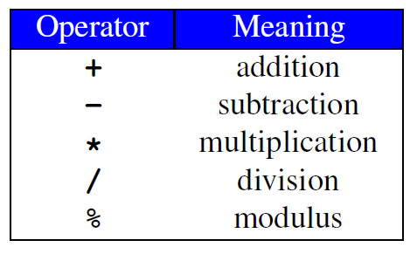
Arithmetic Operators
Used for performing numeric calculations
SYMBOL | OPERATION | EXAMPLE | VALUE OF ans
+ | addition | ans = 7 + 3; | 10
- | subtraction | ans = 7 - 3; | 4
* | multiplication | ans = 7 * 3; | 21
/ | division | ans = 7 / 3; | 2
% | modulus | ans = 7 % 3; | 1

Slide 30
/ Operator
/ (division) operator performs integer division if both operands are integers
cout << 13 / 5; // displays 2
cout << 91 / 7; // displays 13
If either operand is floating point, the result is floating point
cout << 13 / 5.0; // displays 2.6
cout << 91.0 / 7; // displays 13.0

Slide 31
% Operator
% (modulus) operator computes the remainder resulting from integer division
cout << 13 % 5; // displays 3
% requires integers for both operands
cout << 13 % 5.0; // error

Slide 32
Remainder Operator
Remainder is very useful in programming.
For example, an even number % 2 is always 0 and an odd number % 2 is always 1.
So you can use this property to determine whether a number is even or odd.
Suppose today is Saturday and you and your friends are going to meet in 10 days. What day is in 10 days? You can find that day is Tuesday using the following expression:

Slide 33
Expressions
Can create complex expressions using multiple mathematical (and other) operators
An expression can be a constant, a variable, or a combination of constants and variables
Can be used in assignment, with cout, and with other statements:
area = 2 * PI * radius;
cout << "border length of rectangle is: " << 2*(l+w);

Slide 34
Expressions
Expressions are a grouping of variables, constants and operators.
C++ has a defined order of precedence for the order in which operators are used in an expression
It is not just a left-to-right evaluation
Brackets (aka parentheses) can be used to change the defined order in which operators are used.
Example
#include <iostream>
using namespace std;
int main()
{
cout << (1 + 2 + 3) / 3 << endl; // not the same as 1+2+3/3
return 0;
}

Slide 35
Expressions
Multiplication requires an operator:
Area=lw is written as Area = l * w;
There is no exponentiation operator:
Area=s² is written as Area = pow(s, 2);
Parentheses may be needed to specify the order of operations
Example
is written as m = (y2-y1) /(x2-x1);
Note the use of brackets to group variables into expressions and inform the compiler the order of evaluation.
Example
m = (y2-y1) /(x2-x1);

Slide 36
Compound Assignment
C++ has a set of operators for applying an operation to an object and then storing the result back into the object
Examples
int i = 3; i += 4; // i is now 7 Equivalent to i = i + 4 float a = 3.2; a *= 2.0; // a is now 6.4 Equivalent to a = a * 2.0

Slide 37
Shorthand Assignment Operators
Operator Example Equivalent
+= i += 8 i = i + 8
-= f -= 8.0 f = f - 8.0
*= i *= 8 i = i * 8
/= i /= 8 i = i / 8
%= i %= 8 i = i % 8

Slide 38
Assignment Conversions
Floating-point expression assigned to an integer object is truncated
Integer expression assigned to a floating-point object is converted to a floating-point value
Consider
float y = 2.7; int i = 15; int j = 10; i = y; // i is now 2 y = j; // y is now 10.0

Slide 39
Operators and Precedence
Consider m*x + b - Which of the following is it equivalent to?
(m * x) + b - Equivalent
m * (x + b) - Not equivalent but valid!
Operator precedence tells how to evaluate expressions
Standard precedence order
() Evaluate first. If nested innermost done first
* / % Evaluate second. If there are several, then evaluate from left-to-right
+ - Evaluate third. If there are several, then evaluate from left-to-right

Slide 40
Operator Precedence
Example
20 - 4 / 5 * 2 + 3 * 5 % 4
(4 / 5)
((4 / 5) * 2)
((4 / 5) * 2) (3 * 5)
((4 / 5) * 2) ((3 * 5) % 4)
(20 -((4 / 5) * 2)) ((3 * 5) % 4)
(20 -((4 / 5) * 2)) + ((3 * 5) % 4)

Slide 41
Increment and Decrement Operators
C++ has special operators for incrementing or decrementing a variable’s value by one – “strange” effects!
Examples
int k = 4; ++k; // k is 5
k++; // k is 6 Nothing strange so far!
BUT
int i = k++; // i is 6, and k is 7
int j = ++k; // j is 8, and k is 8

Slide 42
Increment and Decrement Operators
The “strange”effects appear when the operators are used in an assignment statement
Operator Name Description
a=++var pre-increment The value in var is incremented by 1 and this new value of var is assigned to a.
a=var++ post-increment The value in var is assigned to a and then the value in var is incremented by 1

Slide 43
Similar effects for the decrement operator
Operator Name Description
a=--var pre-decrement The value in var is decremented by 1 and this new value of var is assigned to a.
a=var-- post-decrement The value in var is assigned to a and then the value in var is decremented by 1

Slide 44
Some Standard Libraries
fstream
- File stream processing
assert
- Assertion processing
iomanip
- Formatted input/output (I/O) requests
ctype
- Character manipulations
cmath
Trigonometric and logarithmic functions
Note
C++ has many other libraries

Slide 45
C++ cmath Library
Typical mathematical functions
e.g. sqrt, sin, cos, log
Function use in an assignment statement
y = sqrt(x);
Function call
Function name
Function argument

Slide 46
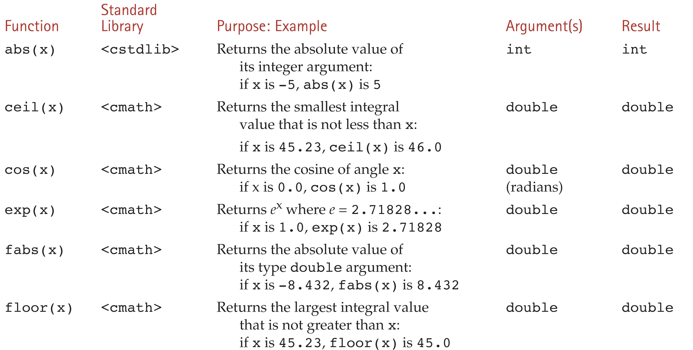
Some Mathematical Library Functions

Slide 47
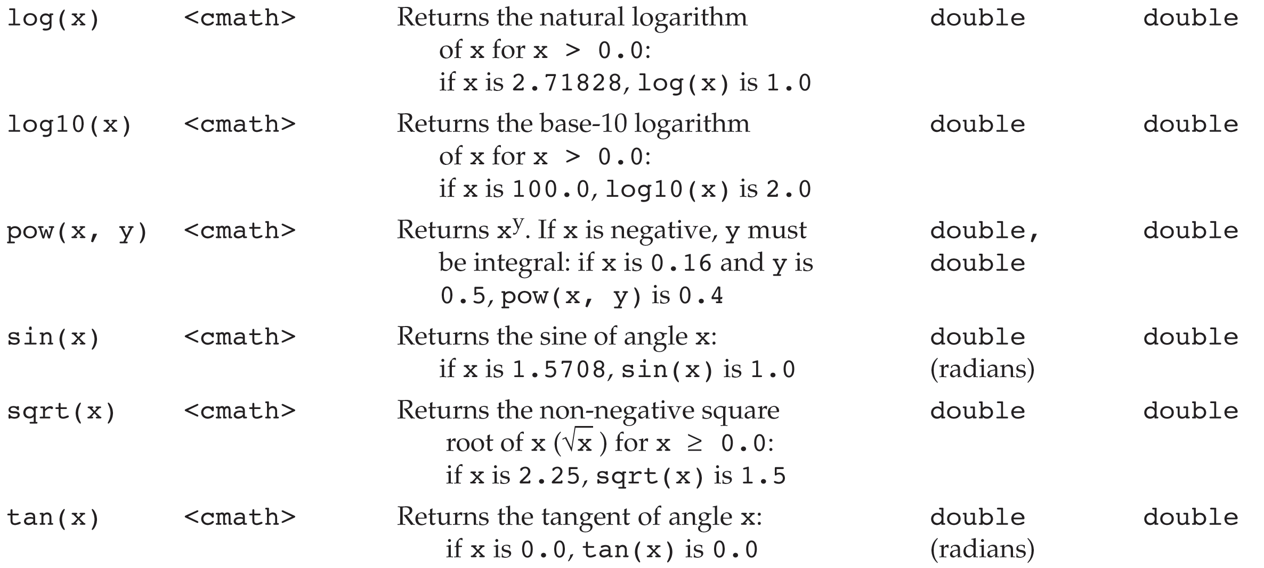

Slide 48
Example
#include <iostream>
#include <cmath>
using namespace std;
int main() {
cout << "Enter Quadratic coefficients: ";
double a, b, c;
cin >> a >> b >> c;
if ( (a != 0) && (b*b - 4*a*c > 0) ) {
double radical = sqrt(b*b - 4*a*c);
double root1 = (-b + radical) / (2*a);
double root2 = (-b - radical) / (2*a);
cout << "Roots: " << root1 << " " << root2;
}
else {
cout << "Does not have two real roots";
}
return 0;
}

Slide 49
Const arguments
In C++ an argument to a function can be declared as const, tells the compiler that the function should not be modify the argument!
If this condition violates then compiler will generate an error
Int strlen(const char *p);
Int length(const string &s);

Slide 50
/*
This program computes the volume (in liters) of a six-pack of soda cans and the total volume of a six-pack and a two-liter bottle.
*/
int main()
{
int cans_per_pack = 6;
const double CAN_VOLUME = 0.355; // Liters in a can
double total_volume = cans_per_pack * CAN_VOLUME;
cout << "A six-pack of 12 cans contains "
<< total_volume << " liters." << endl;
const double BOTTLE_VOLUME = 2; // Two-liter bottle
total_volume = total_volume + BOTTLE_VOLUME;
cout << "A six-pack and a two-liter bottle contain "
<< total_volume << " liters." << endl;
return 0;
}

Slide 51
Common Error – Omitting Semicolons
Common error
Omitting a semicolon (or two)
Oh No!
1 #include <iostream>
2
3 using namespace std;
4
5 int main()
6 {
7 cout << "Hello, World!" << endl
8 return 0;
9 }

Slide 52
Suppose you (accidentally of course) wrote:
cot << "Hello World!" << endl;
count << "Hello World!" << endl;
This will cause a compile-time error and the compiler will complain that it has no clue what you mean by cot. The exact wording of the error message is dependent on the compiler, but it might be something like “Undefined symbol cot”.

Slide 53
Consider this: cout << "Hollo, World!" << endl;
Logic errors or run-time errors are errors in a program that compiles (the syntax is correct), but executes without performing the intended action.
not really an error?

Slide 54
Common Error – Using Undefined Variables
You must define a variable before you use it for the first time.
For example, the following sequence of statements would not
be legal:
double can_volume = 12 * liter_factor;
double liter_factor = 0.0296;
? ?
Statements are compiled in top to bottom order. When the compiler reaches the first statement, it does not know that liter_factor will be defined in the next line, and it reports an error.

Slide 55
Common Error – Using Uninitialized Variables
Initializing a variable is not required, but there is always a value in every variable, even uninitialized ones. Some value will be there, the flotsam left over from some previous calculation or simply the random value there when the transistors in RAM were first turned on.
int bottles; // Forgot to initialize
int bottle_volume = bottles * 2;
What value would be output from the following statement?
cout << bottle_volume << endl;
// Result is unpredictable
// Unpredictable

Slide 56
Common Error – Unintended Integer Division
It is unfortunate that C++ uses the same symbol: / for both integer and floating-point division. These are really quite different operations. It is a common error to use integer division by accident. Consider this segment that computes the average of three integers:
cout << "Please enter your last three test scores: ";
int s1;
int s2;
int s3;
cin >> s1 >> s2 >> s3;
double average = (s1 + s2 + s3) / 3;
cout << "Your average score is " << average << endl;
← ← ← Error

Slide 57
What could be wrong with that?
Of course, the average of s1, s2, and s3 is (s1+ s2+ s3) / 3
Here, however, the / does not mean division in the
mathematical sense.
It denotes integer division because
both (s1 + s2 + s3)and 3 are integers.

Slide 58
For example, if the scores add up to 14,
the average is computed to be 4.
WHAT?
Yes, the result of the integer division of 14 by 3 is 4
How many times does 3 evenly divide into 14?
Right!
That integer 4 is then moved into the floating-point
variable average.
So 4.0 is stored.
That’s not what we want!

Slide 59
The remedy is to make the numerator or denominator into a floating-point number:
double total = s1 + s2 + s3;
double average = total / 3;
or
double average = (s1 + s2 + s3) / 3.0;

Slide 60
Common Error – Unbalanced Parentheses
Consider the expression
(-(b * b - 4 * a * c) / (2 * a)
What is wrong with it?
?
The parentheses are unbalanced. This is very common with complicated expressions.

Slide 61
Common Error – Roundoff Errors
This program produces the wrong output:
#include <iostream>
using namespace std;
int main()
{
double price = 4.35;
int cents = 100 * price;
// Should be 100 * 4.35 = 435
cout << cents << endl;
// Prints 434!
return 0;
}
Why?

Slide 62
Common Error – Roundoff Errors
In the computer, numbers are represented in the binary number system, not in decimal.
In the binary system, there is no exact representation for 4.35, just as there is no exact representation for ⅓ in the decimal system.
The representation used by the computer is just a little less than 4.35, so 100 times that value is just a little less than 435.
The remedy is to add 0.5 in order to round to the nearest integer:
int cents = 100 * price + 0.5;

Slide 63
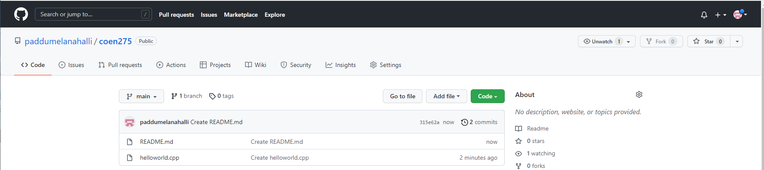
Github repo
https://github.com/paddumelanahalli/coen275
Complete - 05-11 Programs

Slide 64
Thank You!

